Slide 1

Credit Card Fraud Detection
Fintech Future:
Sarah Almaghthawi
Nada Alghamdi
Malak Alsuroor
Amjad Alqarni
Somaya Abodabeel

Slide 2
Detecting credit card fraud is extremely important. We must detect potential fraud so that consumers cannot pay the bill for goods they have not purchased. Thus, the goal is to create a classifier that shows whether the requested transaction is fraudulent.
Transactions made with credit cards were taken in September 2013 by European cardholders in order to discover frauds that took place during this period.

Slide 3
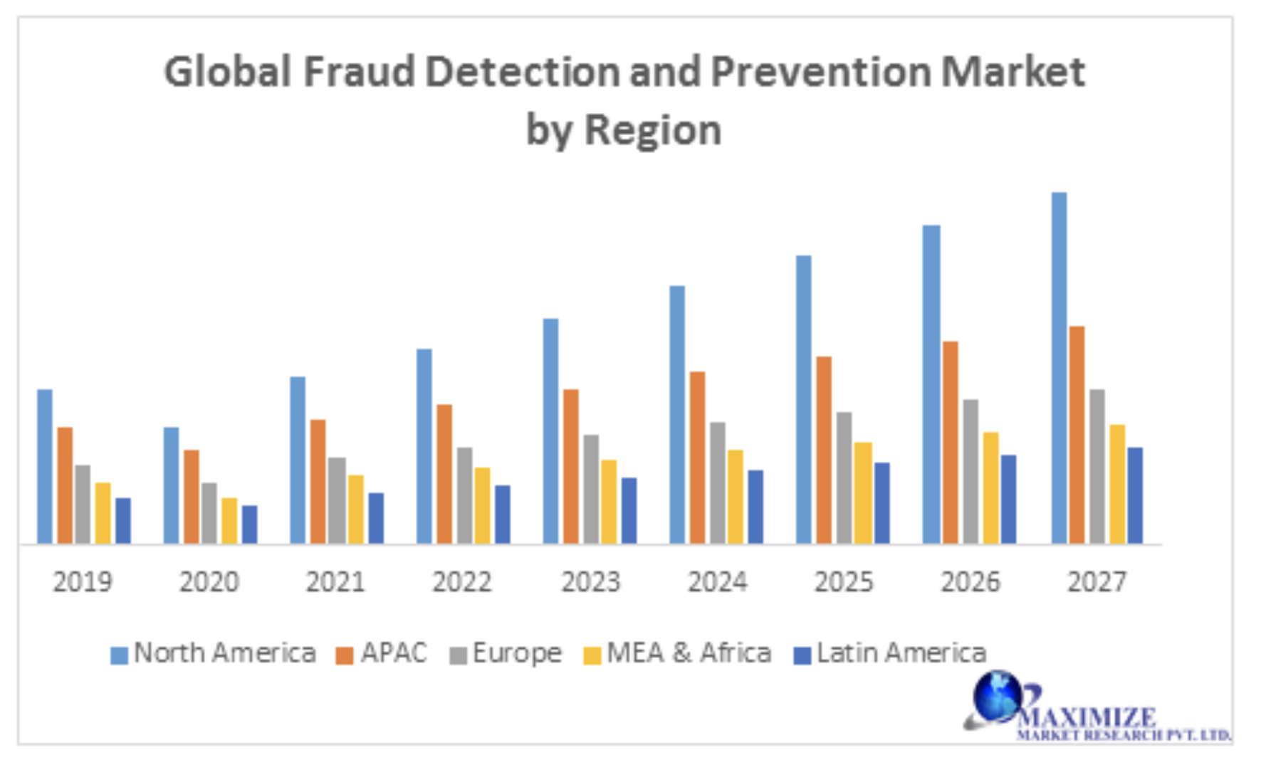
Due to the growing volume of electronic payments, the monetary strain of credit-card fraud is turning into a substantial challenge for financial institutions and service providers, thus forcing them to continuously improve their fraud detection systems.
Global Fraud Detection and Prevention Market was valued at USD 23.53 Bn in 2019 and is expected to reach at USD 28.62 Bn by 2027 at a CAGR of 21.65% over forecast period 2020-2027.

Slide 4
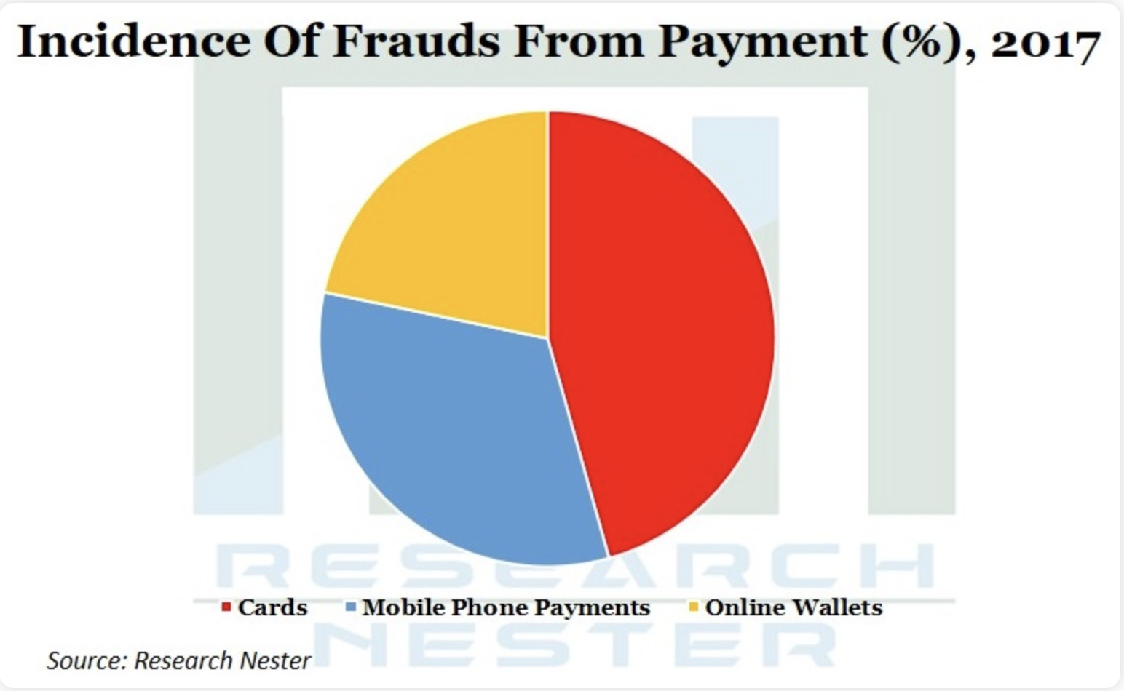
According to studies, fraud Cards are the highest percentage of digital fraud.

Slide 5
Positive aspects of applying technology to the case
Fraud Detection is one technology concept which aims to use artificial intelligence, machine learning, workflow and automation to track fraud in real-time.
This promotes the destruction of fraud system.
Lead to a decrease in the overall cost of fraud by reducing overheads.
And most importantly, increasing the detection and prevention rate of fraud.
Bringing banks closer to their customer and enhancing the value of their services by preventing financial thefts.

Slide 6
Dataset
The dataset contains transactions made by credit cards in September 2013 by European cardholders.
This dataset presents transactions that occurred in two days.
492 frauds out of 284,807 transactions.
The dataset is highly unbalanced, class (frauds) account for 0.172% of all transactions.
Unfortunately, due to confidentiality issues, we cannot provide the original features and more background information about the data. Features V1, V2, … V28.
Features which have not been transformed 'Time' and ' 'Amount’.
'Time' contains the seconds elapsed between each transaction and the first transaction in the dataset.
'Amount' is the transaction Amount.
Feature 'Class' is the response variable, and it takes value 1 in case of fraud and 0 otherwise.
The data was divided into 75% training 25% testing.

Slide 7
Model
Logistic regression
K Nearest Neighbor(KNN)
Random Forest classifier

Slide 8
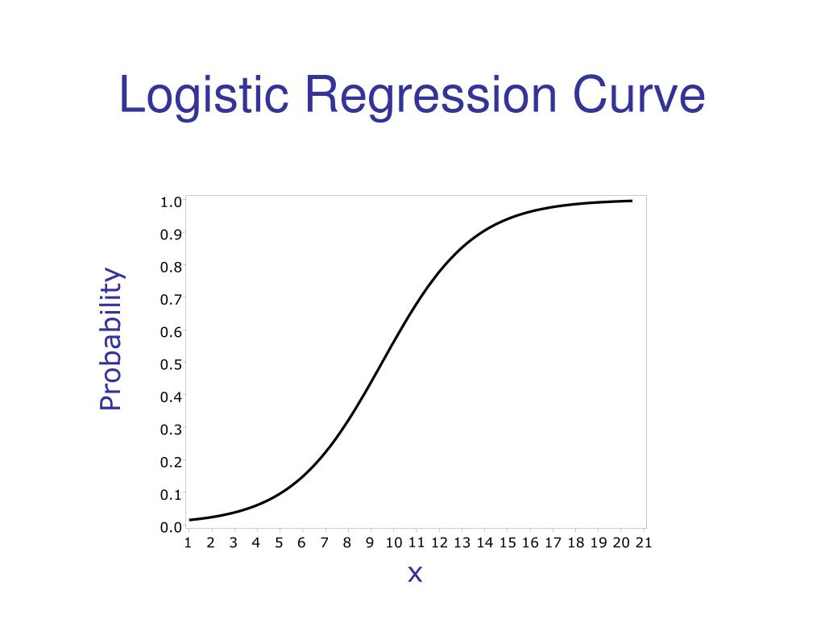
Model selected (Logistic regression)
Logistic regression
Is the appropriate regression analysis to conduct when the dependent variable is dichotomous (binary).
Logistic regression has the following advantages
Logistic regression is very efficient to train.
It makes no assumptions about the distributions of classes in the feature space.
It can easily be extended to multiple classes (multinomial regression).
It is very efficient for classifying unknown records.

Slide 9
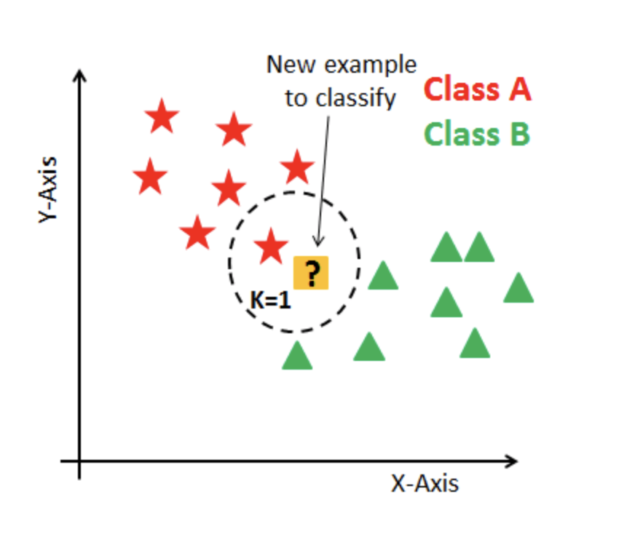
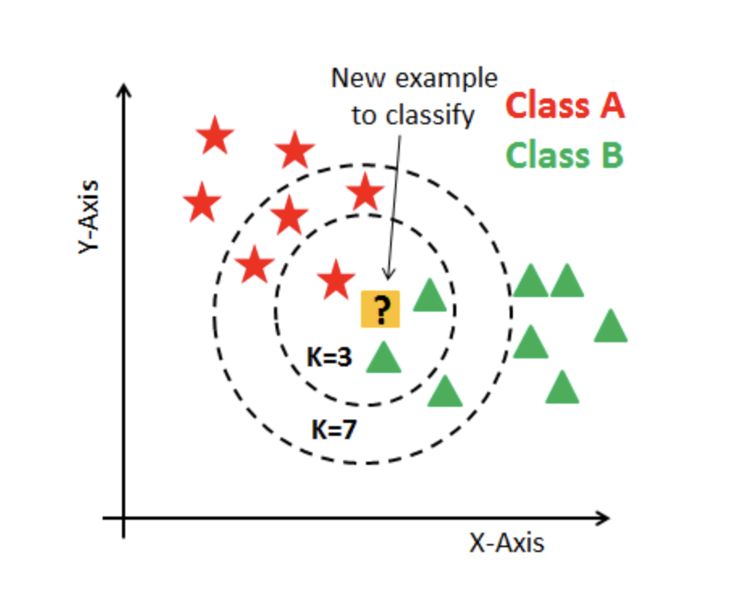
KNN classifier
K Nearest Neighbor(KNN) is a very simple, easy to understand, KNN used in the variety of applications such as finance, healthcare, political science, handwriting detection, image recognition and video recognition.
Basic steps:
1- We determine the value of the variable k, which expresses the number of neighbours
2- Calculate the value of the distance between the new example and the examples in the dataset 3- We arrange the examples to get the neighbours based on the least distance that was calculated in the previous step and take the number of k adjacent from them
4- We define the class for the neighbours
5- The most common class for the neighbours is the expected class for this example

Slide 10
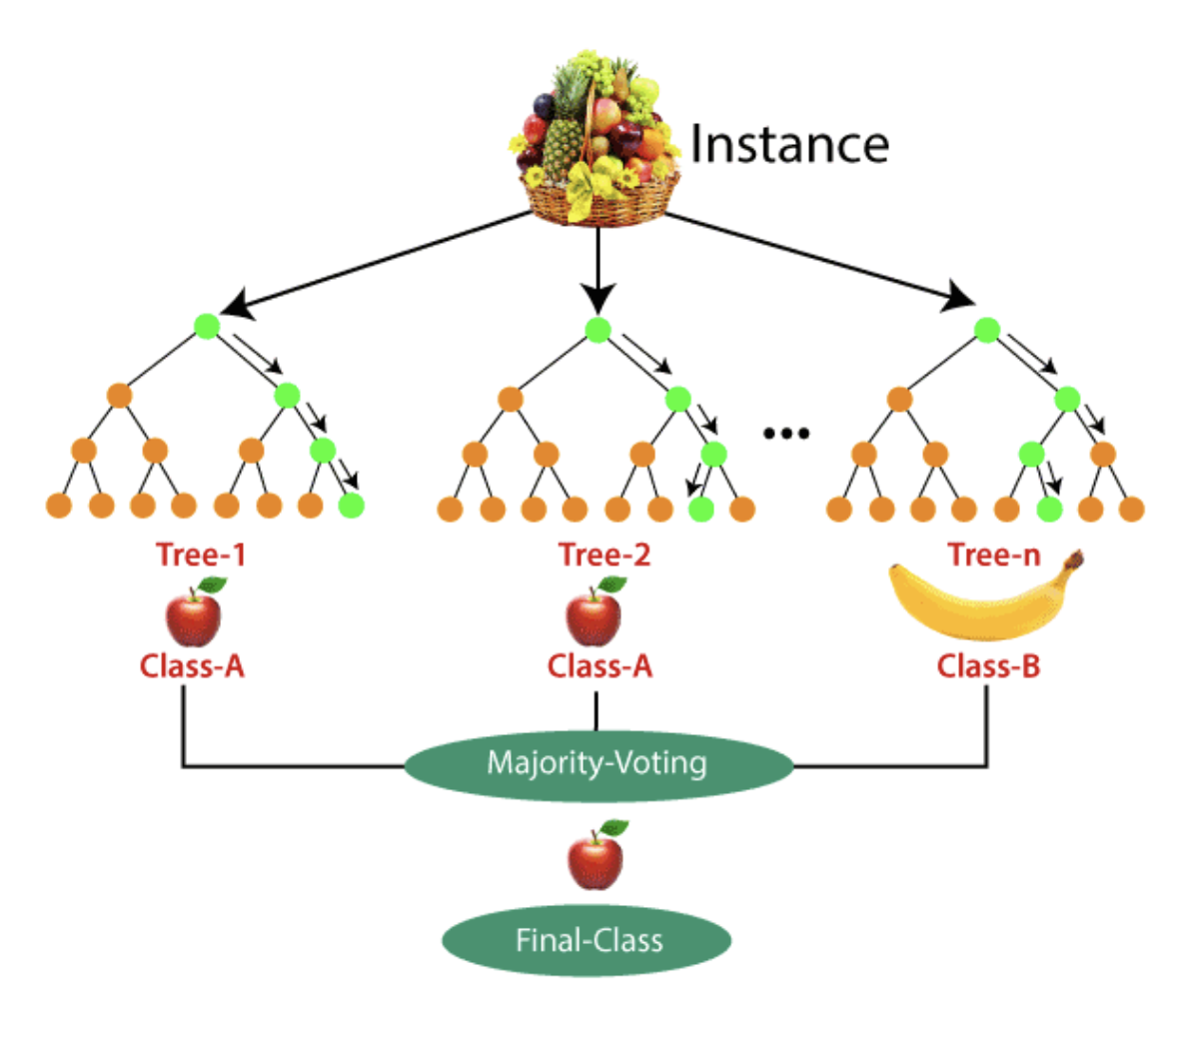
Random Forest classifier
Random forest is a Supervised Machine Learning Algorithm that is used widely in Classification and Regression problems. It builds decision trees on different samples and takes their majority vote for classification and average in case of regression.
Steps involved in random forest algorithm:
Step 1: In Random forest n number of random records are taken from the data set having k number of records.
Step 2: Individual decision trees are constructed for each sample.
Step 3: Each decision tree will generate an output.
Step 4: Final output is considered based on Majority Voting or Averaging for Classification and regression, respectively.

Slide 11
KNN vs. Random Forest
classifier | KNN | Random Forest
Time | 19 m 4 s | 6 m 42 s
accuracy_score | 0.9462093761411197 | 0.9994663071262043
roc_auc_score | 0.711052171300304 | 0.9527897311161015
Given the class imbalance ratio, we recommend measuring the accuracy using the Area Under the Precision-Recall Curve (AUPRC).
Confusion matrix accuracy is not meaningful for unbalanced classification.

Slide 12
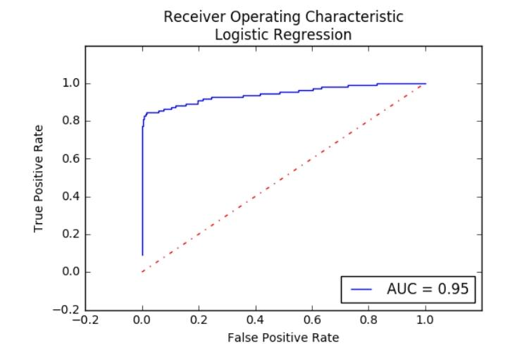
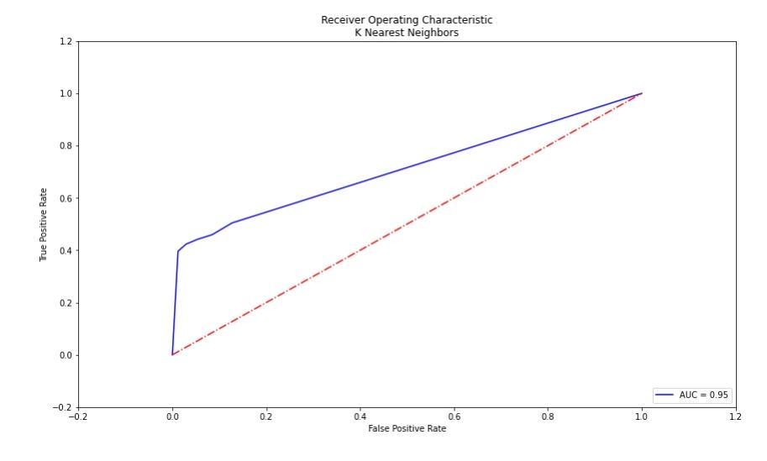
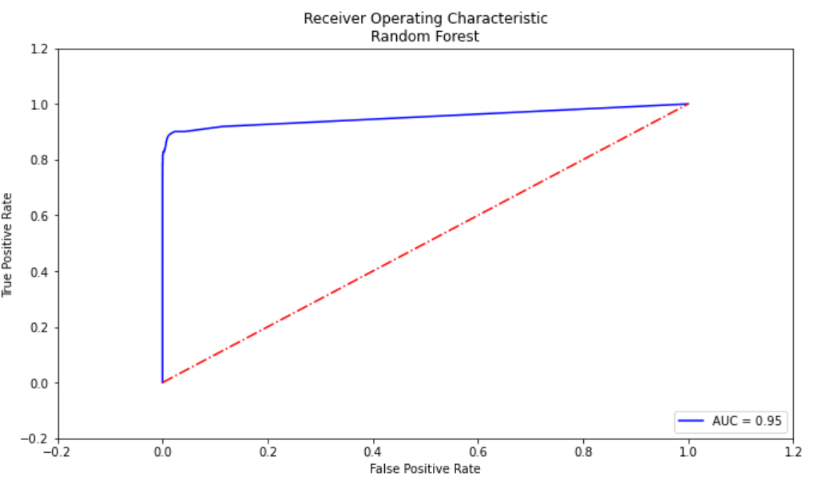
ROC curve for Logistic Regression
ROC curve for KNN
Given the class imbalance ratio, we recommend measuring the accuracy using the Area Under the Precision-Recall Curve (AUPRC).
Confusion matrix accuracy is not meaningful for unbalanced classification.
Random forest has the highest accuracy score.
ROC curve for Random Forest

Slide 13
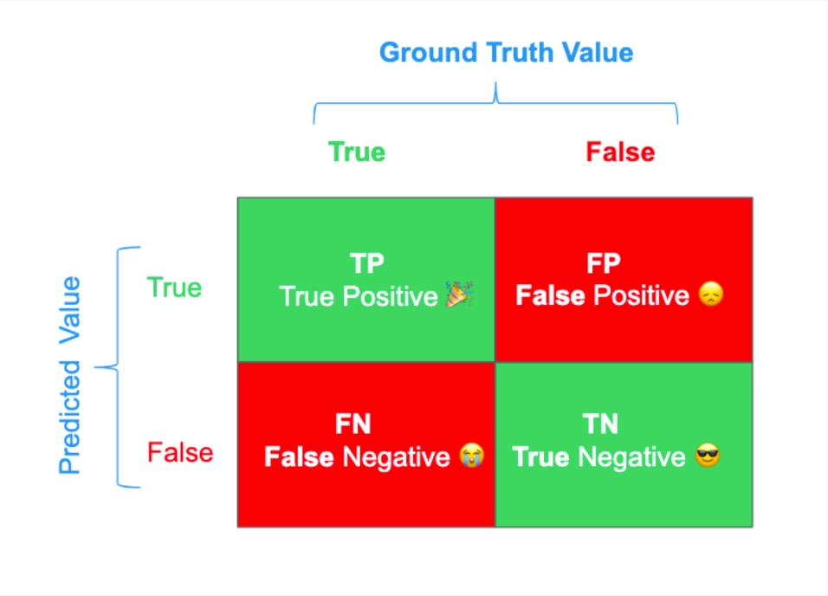
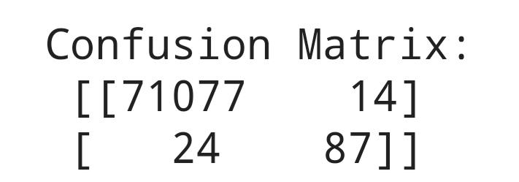
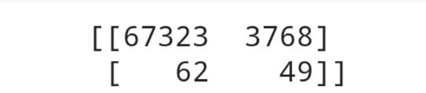

Random Forest
KNN
Logistic regression

Slide 14
References:
https://www.analyticsvidhya.com/blog/2021/06/understanding-random-forest/
https://www.datacamp.com/community/tutorials/k-nearest-neighbor-classification-scikit-learn
https://thesai.org/Downloads/Volume11No12/Paper_65-Fraud_Detection_in_Credit_Cards.pdf
https://www.businesswire.com/news/home/20180820005655/en/Fraud-Analytics-Solution-for-a-Financial-Services-Company-Helped-Devise-the-Perfect-Solution-for-Fraud-Detection-in-Banking-Quantzig
https://www.fraud.com/post/how-fraud-risk-management-can-help-the-banking-industry-lower-its-costs/
https://www.maximizemarketresearch.com/market-report/global-fraud-detection-and-prevention-market/62819/
https://www.researchnester.com/reports/online-payment-fraud-detection-market/1861
https://www.researchnester.com/reports/online-payment-fraud-detection-market/1861
https://www.sciencedirect.com/science/article/abs/pii/S0167923621000026
https://soluzionesolare.com/guides/difference-between-accuracy-and-precision/
https://blog.floydhub.com/a-pirates-guide-to-accuracy-precision-recall-and-other-scores/

